Slide 1




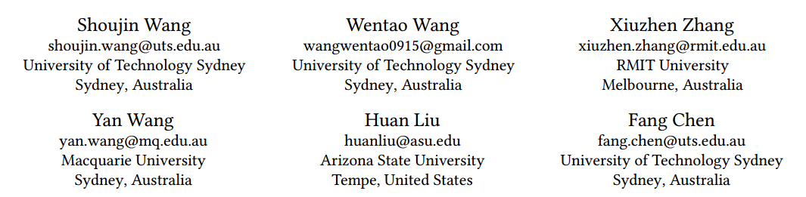





ATAI
Advanced Techniqueof Artificial Intelligence
ATAI
ChongqingUniversity _{AdvancedTechniqueof}
of Technology Artificial Intelligence
Chongqing University of
Technology
Chongqing University ^{ATAI}
_{of Technology} Advanced Techniqueof
Artificial Intelligence
Chongqing University of Technology
Chongqing University of Technology
A Hierarchical and Disentangling Interest Learning Framework
for Unbiased and True News Recommendation
Code: none
2024.10. 17•ChongQing
—— KDD 2024
Reported by Yao Yao Zhang
1

Slide 2

ATAI
AdvancedTechniqueof
Artificial Intelligence
ATAI
ChongqingUniversity _{AdvancedTechniqueof}
of Technology Artificial Intelligence
ChongqingUniversity of Technology
Motivation
（1）Existing news RSs often oversimplify users’ reading interests, neglecting their hierarchical nature.
（2）Existing news RSs often assume a simplistic context, disregarding the prevalence of political bias and fake news under the real-world context . This oversight easily leads to biased and/or fake news recommendation.Accordingly, we propose a novel unified Hierarchical and Disentangling Interest learning framework (HDInt) for accurate, unbiased and true news recommendations.

Slide 3

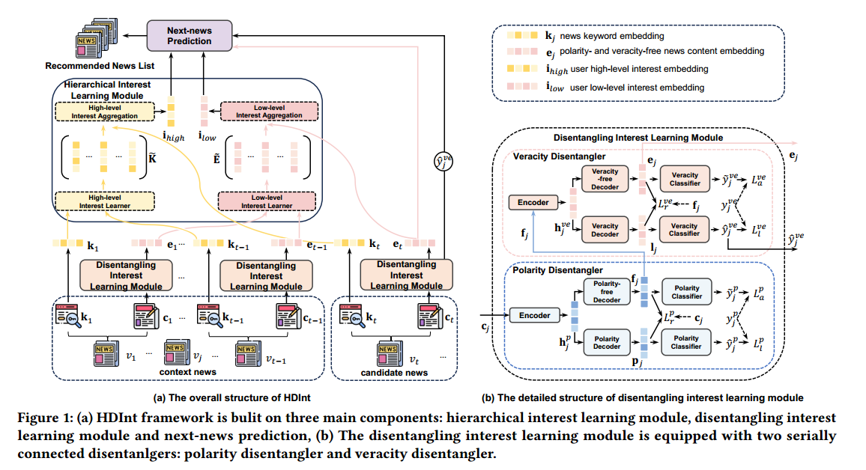
ChongqingUniversity of Technology
ATAI
AdvancedTechniqueof
Artificial Intelligence
ATAI
ChongqingUniversity _{AdvancedTechniqueof}
of Technology Artificial Intelligence
Overview

Slide 4

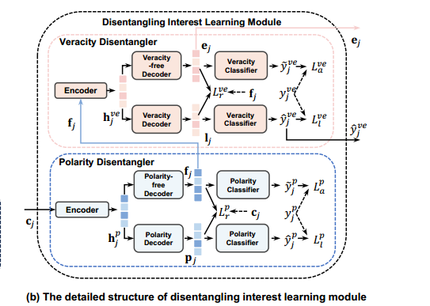



ChongqingUniversity of Technology
ATAI
AdvancedTechniqueof
Artificial Intelligence
ATAI
ChongqingUniversity _{AdvancedTechniqueof}
of Technology Artificial Intelligence
Method

Slide 5



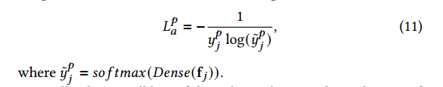


ChongqingUniversity of Technology
ATAI
AdvancedTechniqueof
Artificial Intelligence
ATAI
ChongqingUniversity _{AdvancedTechniqueof}
of Technology Artificial Intelligence
Method

Slide 6
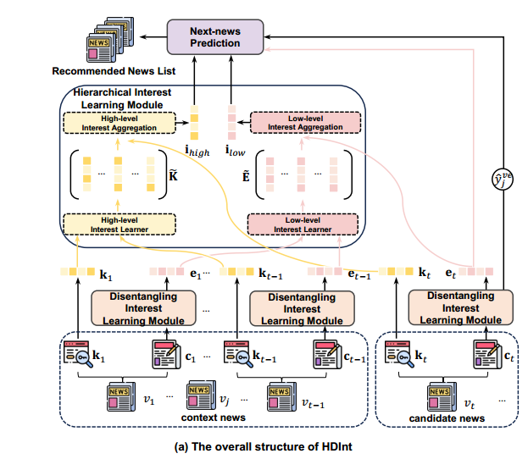

ChongqingUniversity of Technology
ATAI
AdvancedTechniqueof
Artificial Intelligence
ATAI
ChongqingUniversity _{AdvancedTechniqueof}
of Technology Artificial Intelligence
Method

Slide 7
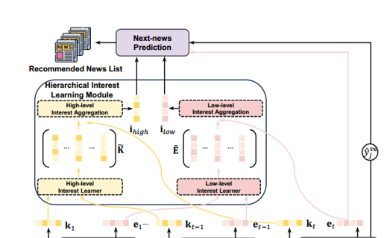


ChongqingUniversity of Technology
ATAI
AdvancedTechniqueof
Artificial Intelligence
ATAI
ChongqingUniversity _{AdvancedTechniqueof}
of Technology Artificial Intelligence
Method

Slide 8



ChongqingUniversity of Technology
ATAI
AdvancedTechniqueof
Artificial Intelligence
ATAI
ChongqingUniversity _{AdvancedTechniqueof}
of Technology Artificial Intelligence
Method

Slide 9
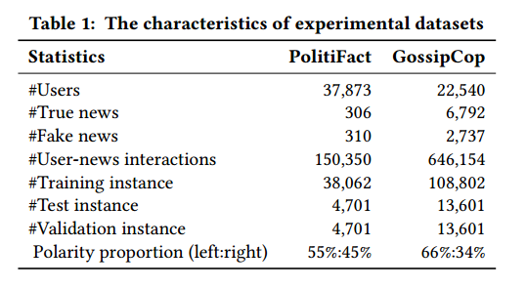
ATAI
AdvancedTechniqueof
Artificial Intelligence
ATAI
ChongqingUniversity _{AdvancedTechniqueof}
of Technology Artificial Intelligence
ChongqingUniversity of Technology
Experiments

Slide 10
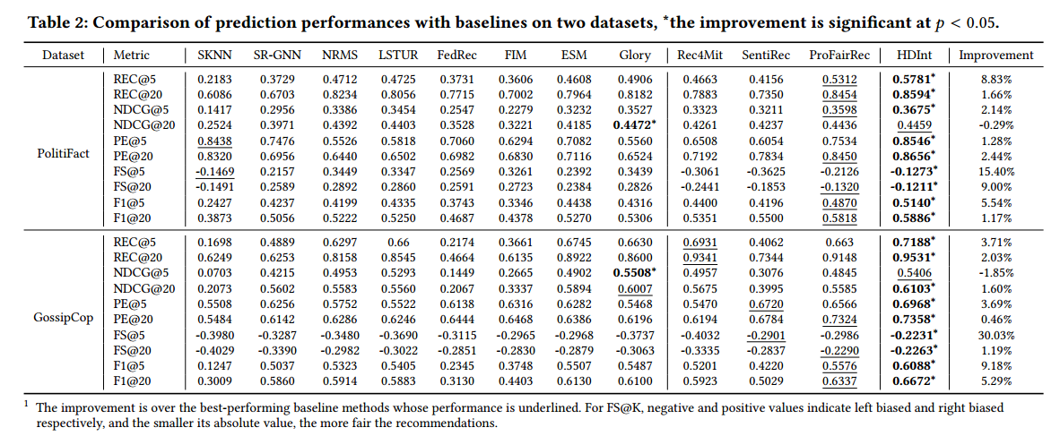
ATAI
AdvancedTechniqueof
Artificial Intelligence
ATAI
ChongqingUniversity _{AdvancedTechniqueof}
of Technology Artificial Intelligence
ChongqingUniversity of Technology
Experiments

Slide 11

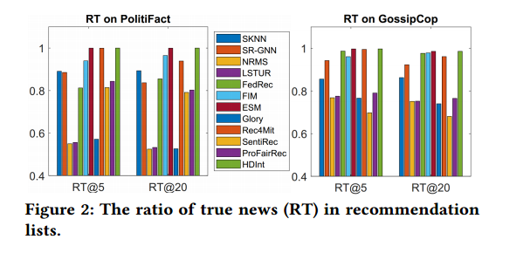
ATAI
AdvancedTechniqueof
Artificial Intelligence
ATAI
ChongqingUniversity _{AdvancedTechniqueof}
of Technology Artificial Intelligence
ChongqingUniversity of Technology
Experiments

Slide 12
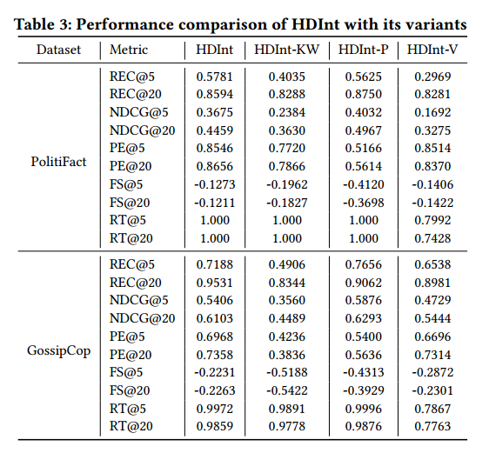
ATAI
AdvancedTechniqueof
Artificial Intelligence
ATAI
ChongqingUniversity _{AdvancedTechniqueof}
of Technology Artificial Intelligence
ChongqingUniversity of Technology
Experiments

Slide 13
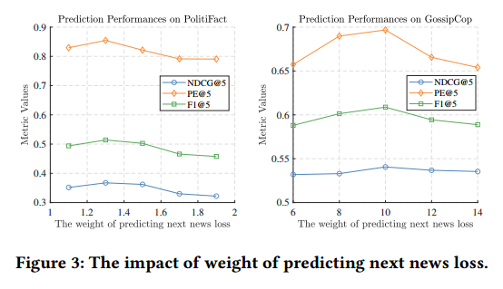
ATAI
AdvancedTechniqueof
Artificial Intelligence
ATAI
ChongqingUniversity _{AdvancedTechniqueof}
of Technology Artificial Intelligence
ChongqingUniversity of Technology
Experiments

Slide 14
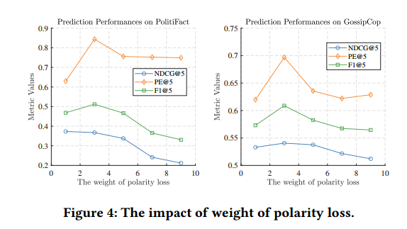
ATAI
AdvancedTechniqueof
Artificial Intelligence
ATAI
ChongqingUniversity _{AdvancedTechniqueof}
of Technology Artificial Intelligence
ChongqingUniversity of Technology
Experiments

Slide 15
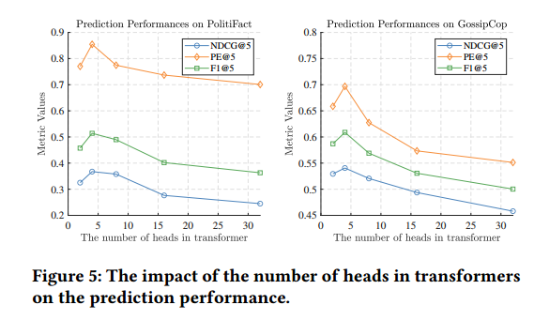
ATAI
AdvancedTechniqueof
Artificial Intelligence
ATAI
ChongqingUniversity _{AdvancedTechniqueof}
of Technology Artificial Intelligence
ChongqingUniversity of Technology
Experiments

Slide 16
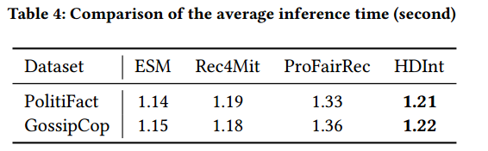
ATAI
AdvancedTechniqueof
Artificial Intelligence
ATAI
ChongqingUniversity _{AdvancedTechniqueof}
of Technology Artificial Intelligence
ChongqingUniversity of Technology
Experiments

Slide 17


ChongqingUniversity of Technology
ATAI
AdvancedTechniqueof
Artificial Intelligence
ATAI
ChongqingUniversity _{AdvancedTechniqueof}
of Technology Artificial Intelligence
Thanks!

